Slide 1
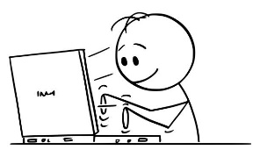
The Inspector General Action Process
Issue or allegation?
IG appropriate
I require Assistance
Confidentiality
Select a COA (investigation or assistance inquiry, refer, inspection)
“Chain of command cannot resolve.
I don’t know where to go. I need IG assistance”
Not local IG appropriate
Help!
IG
Complainant
IG
Analysis
Warm handoff to another agency for established redress (local CoC, outside CoC, referral to another IG office, referral to other service
Step 1 of the IGAP
(Receive the IGAR)
Step 2 of the IGAP
(Preliminary analysis)
If no, go back to step 4
of the IGAP
Send complainant final reply
Close the IGAR
Make appropriate reports
Analyze for trends
Referral to the command or another agency, or IG action
IG
Complainant
IG fact-finding (plan, gather, evaluate, resolve) or follow command-referral process
Notification of results
IG
allegations or issues addressed
Step 3 of the IGAP
(Initiate referrals and make initial notifications)
Step 4 of the IGAP
(IG fact-finding)
Step 5 of the IGAP
(Make notification of results)
Step 6 of the IGAP
(Follow-Up)
Step 7 of the IGAP
(Close the IGAR)

